Slide 1
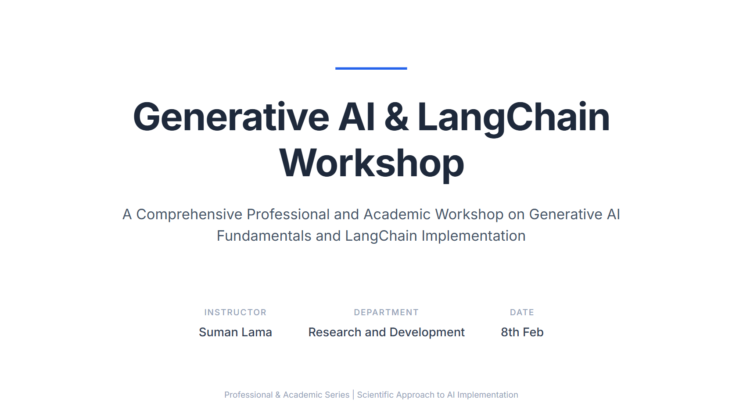

Slide 2
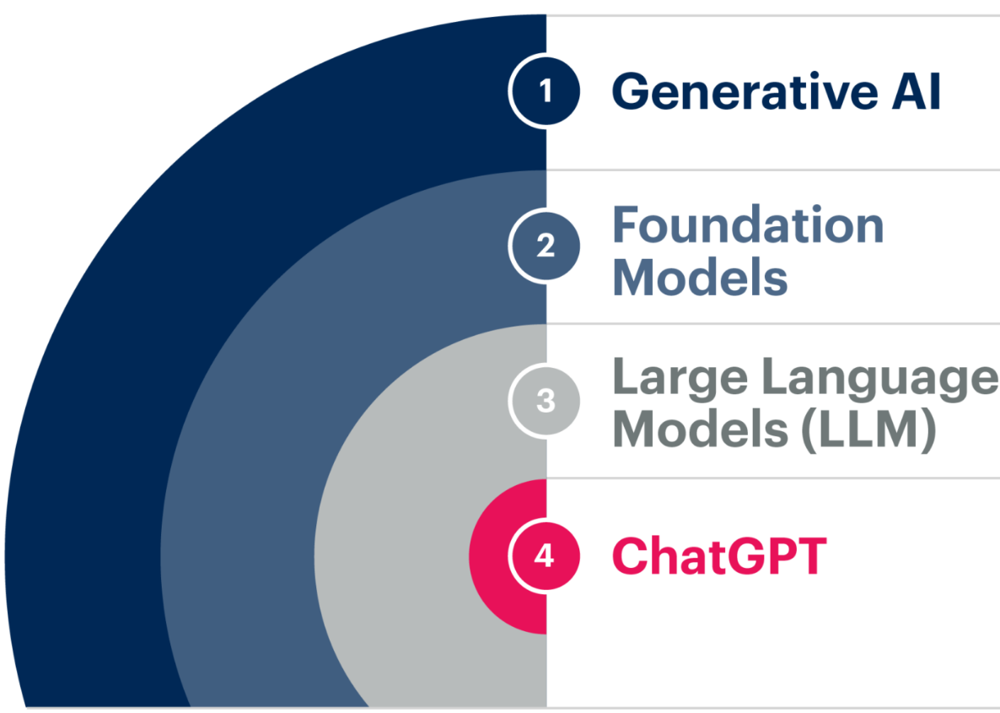
What is Generative AI?
Definition
GenAI is a type of artificial intelligence that creates new content like text, image, or code by learning the patterns from existing data, mimicking human creativity.

Slide 3
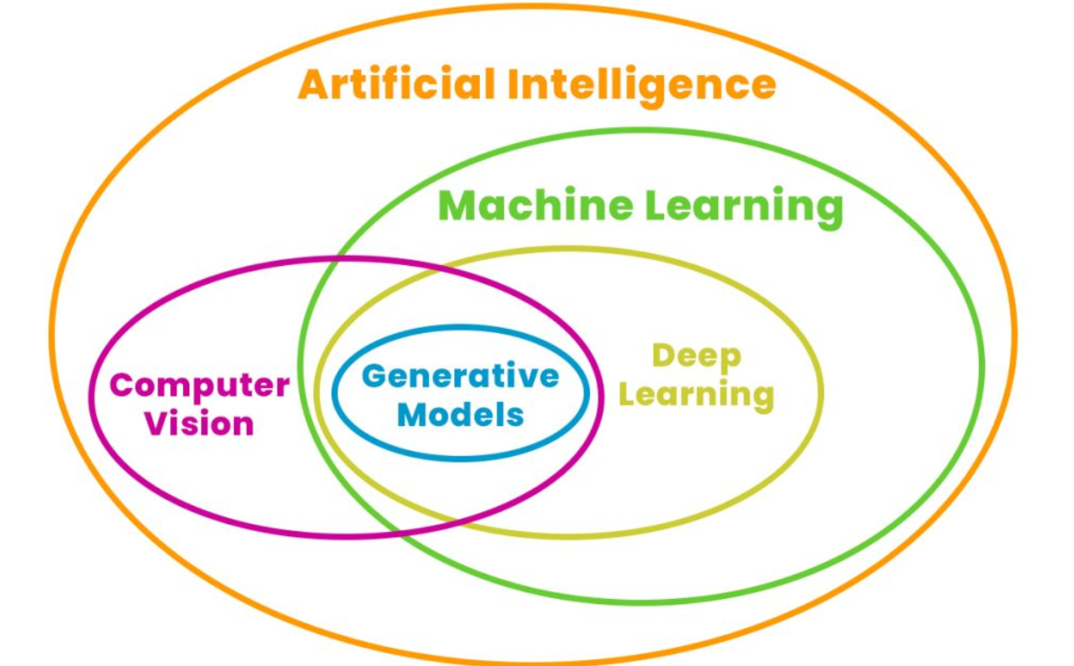
GenAI in Ai Field

Slide 4
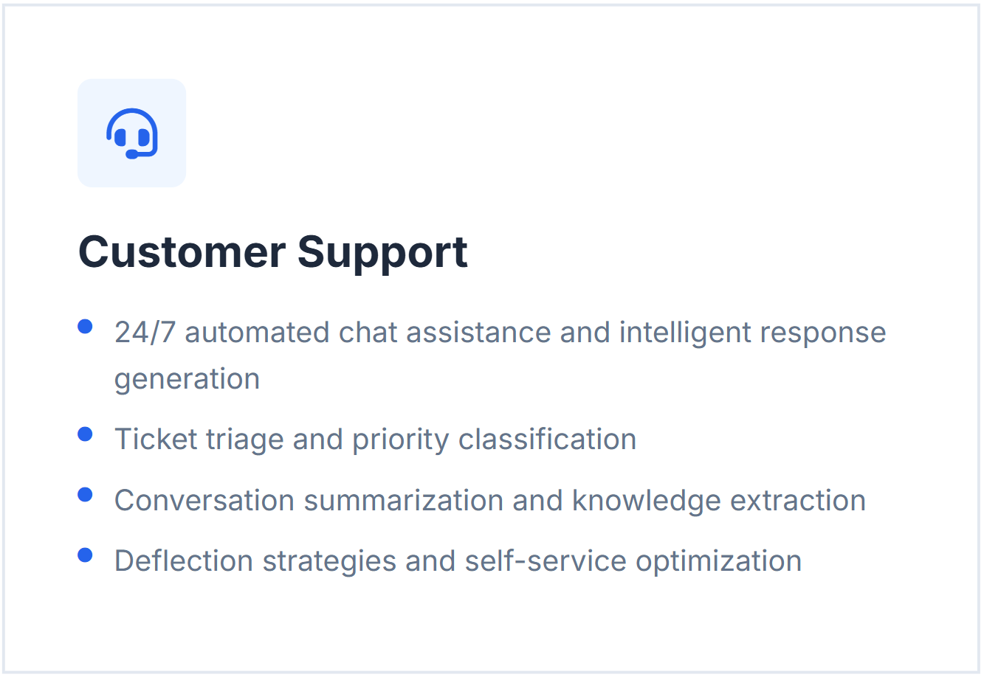
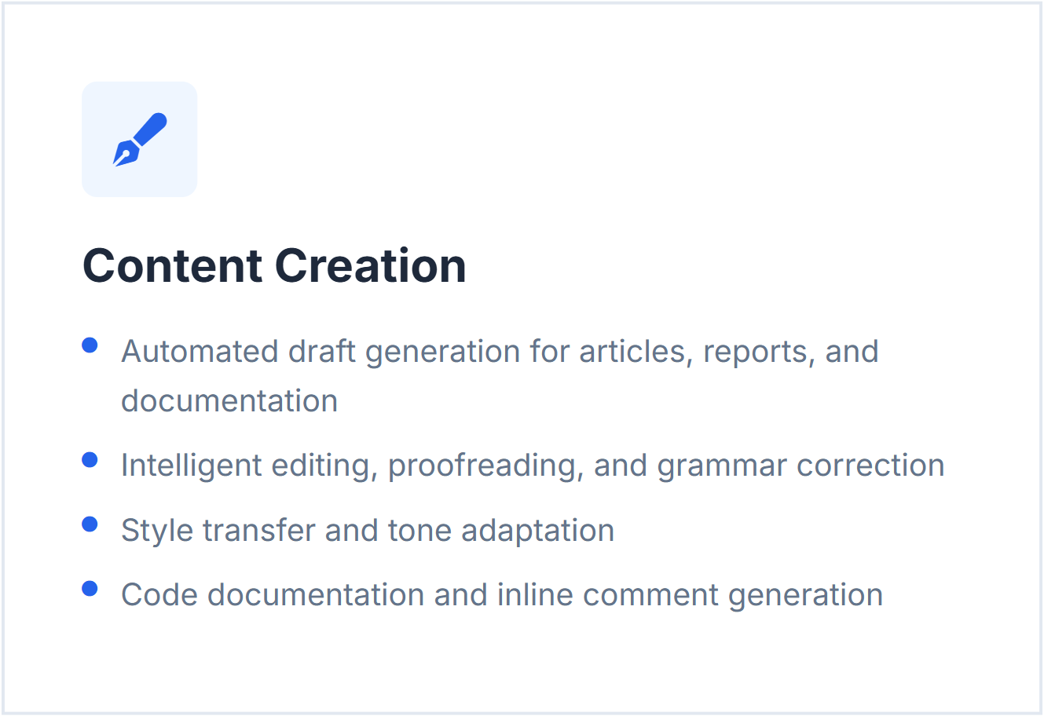
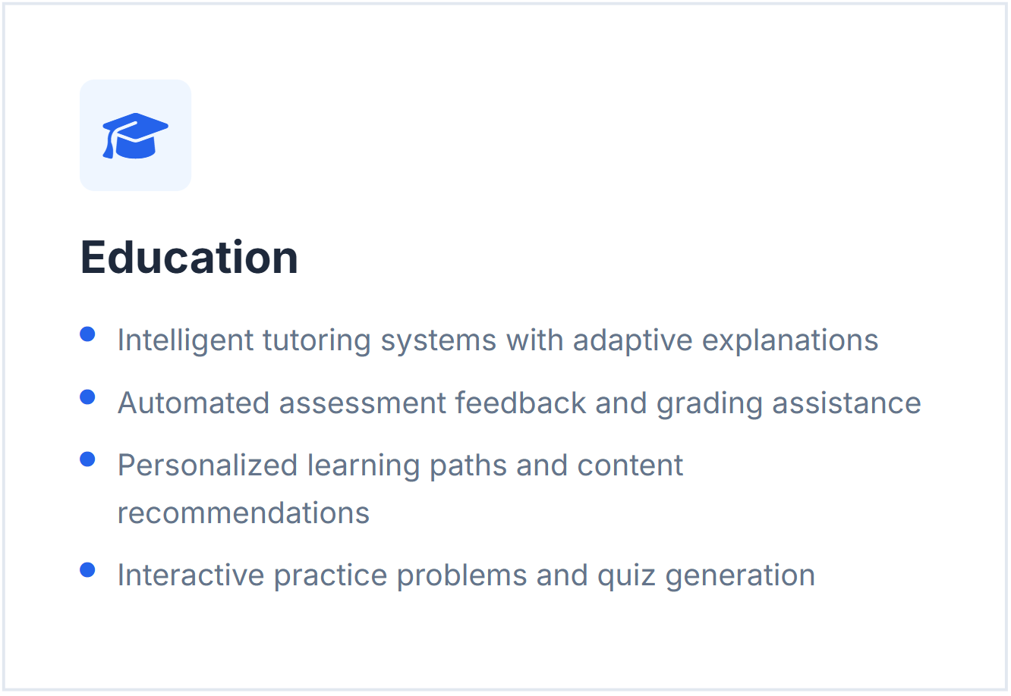
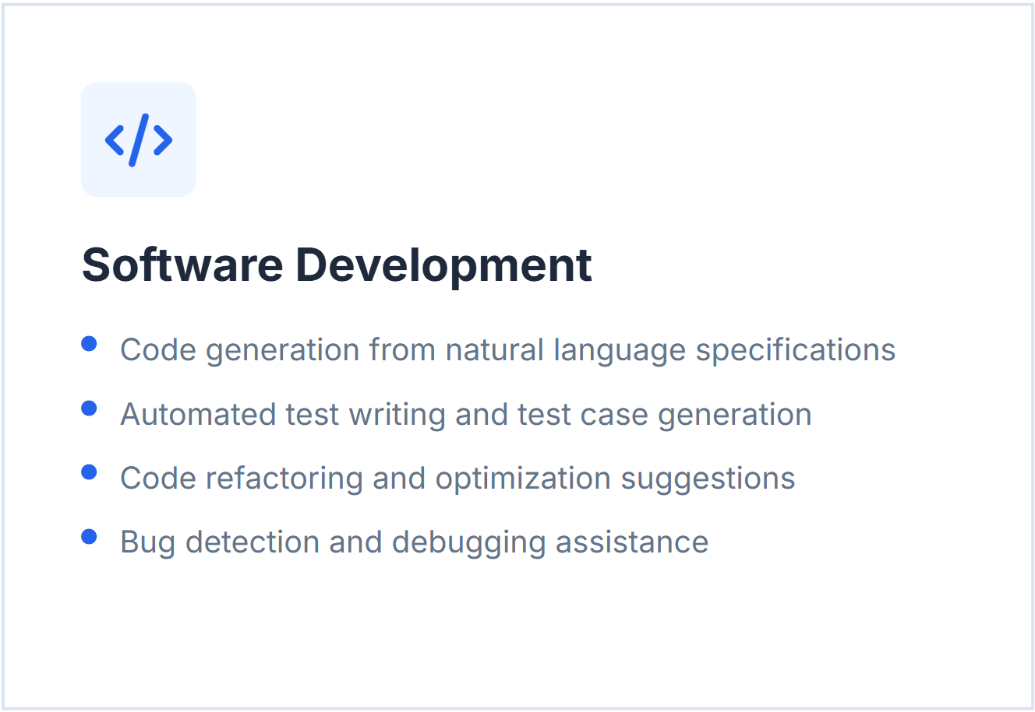
GenAI Impact Areas

Slide 5
Is GenAI Successful?
Q1. Does it solve real world problems?
Ans: Yes – Automation, Efficiency, Smart solutions(chatbots)
Q2. IS it useful on a daily basis?
Ans: Yes – Writing, Studying, Coding, Searching
Q3. Is it impacting the world economics?
Ans: Yes – Productivity growth, Cost reduction, New markets
Q4. Is creating new jobs?
Ans: Yes – AI Engineer, Prompt Engineer, Data Scientist, AI Trainer

Slide 6

Mental model: Foundation Model
Foundation
Model
Builder Perspective
User perspective

Slide 7
Understanding builder and user perspective
Prompt Engineering
RAG
Pretraining
Ai Agents
Vector Databases
Fine tuning
User perspective
Builder Perspective

Slide 8
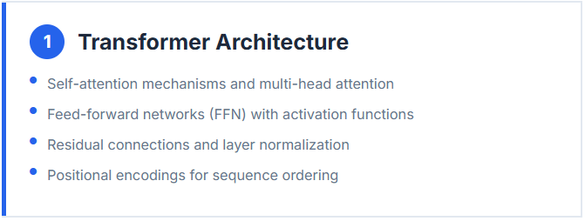
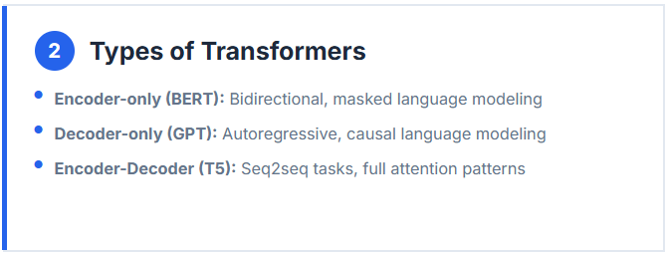
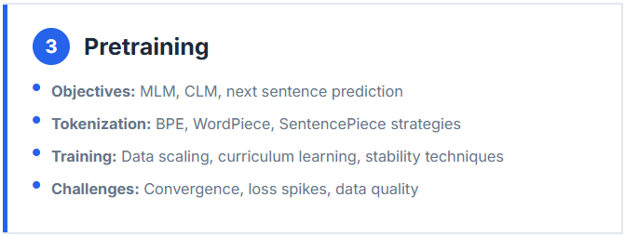
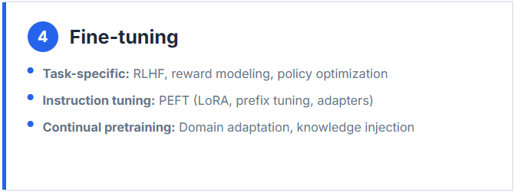
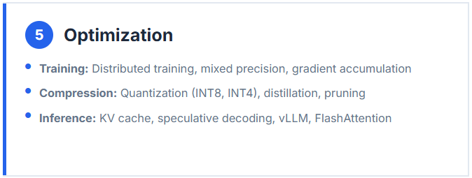
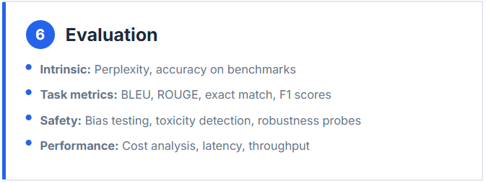
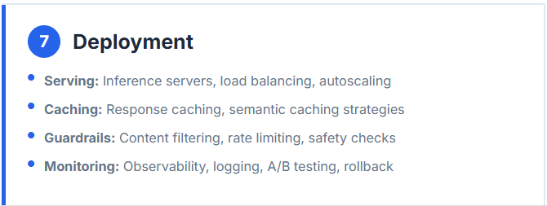
Builder Perspective: From Architecture to Deployment

Slide 9
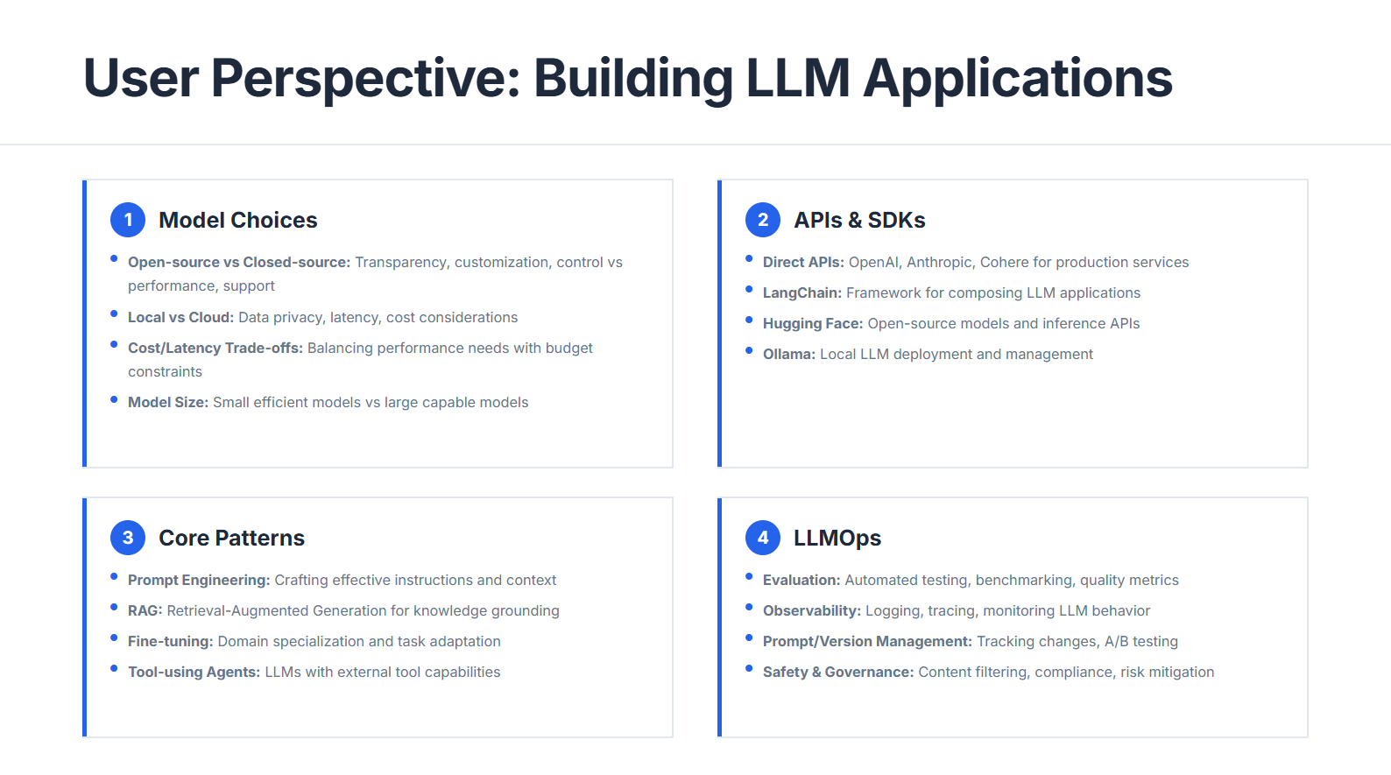

Slide 10
Do we need to learn both?
Builder Side
Data Scientist
Ai
Engineer
User Side
Software engineer

Slide 11

What is LangChain?
Definition
LangChain is an open-source framework that helps in building LLM based applications. It provides modular components and end-to-end tools that helps to developers build complex AI applications, such as chatbots, question-answering systems, RAG, autonomous agent and more.
Supports all the major LLMs.
Simplifies developing LLM based applications.
Open source/free/actively developed
Supports all major GenAI use cases

Slide 12
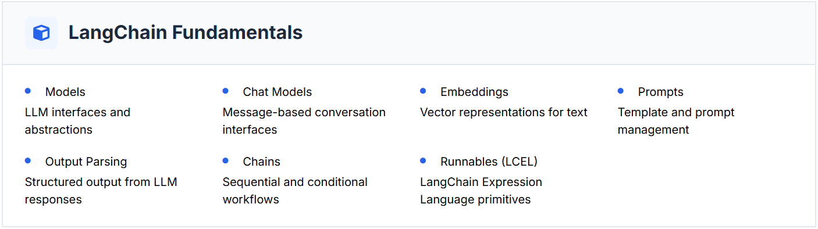
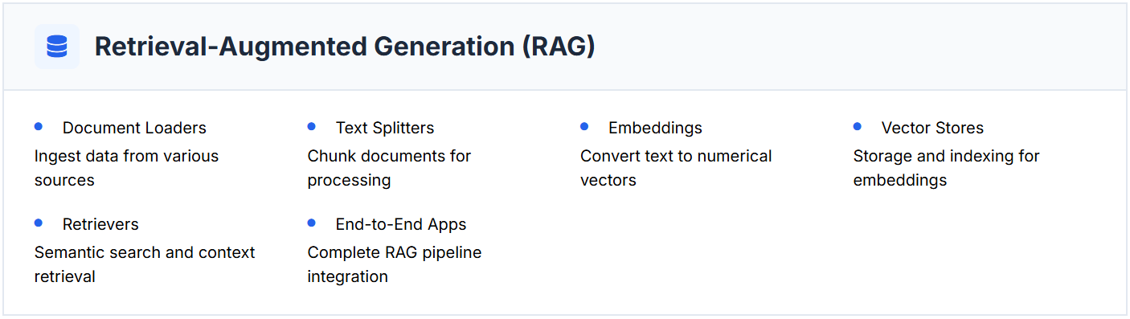
Curriculum Structure-Fundamentals

Slide 13
Why do we need LangChain?
Example:
Research Assistant
Research Assistant
Example:
Summarized the paper.
Explain page no 5 in simplest way.
Make a MCQ questions.
Generate notes.
Chat

Slide 14


Behind the Scene-Research Assistant
PDF
Result
Output
System Query
Semantic search
Page
LLM

Slide 15
Behind the Scene-Research Assistant
Paragraph about college.
0.45,0.56,1,………………………….(100 dim)
Paragraph about cricket.
0.34,0.56,1,………………………….
What is the height of Mt. Everest?
Paragraph about animal.
0.48,0.86,1,………………………….
0.55,0.56,1,………………………….(100 dim)
Paragraph about robotics.
0.84,0.96,1,………………………….
Note: An embedding is a way of converting text, images, or data into numerical vectors so that machines can understand the meaning and similarity between them. Example: Word2Vec, GloVe, FastText etc.

Slide 16
Behind the Scene-Research Assistant
What is the height of Mt. Everest?
Paragraph about college.
[0.45,0.56,1,………………………….]
(100 dim)
[0.55,0.56,1,………………………….]
(100 dim)
Paragraph about cricket.
[0.34,0.56,1,………………………….]
Paragraph about animal.
[0.48,0.86,1,…………………………]
Query
Paragraph about robotics.
[0.84,0.96,1,…………………………]

Slide 17
Behind the Scene-Research Assistant
PDF
AWS S3
Page 1
embedding 1
upload
Doc loader
Page 2
embedding 2
PDF
Page 3
embedding 3
Text splitter
Page 100
embedding 100
Output
Database
System Query
Semantic search
Embedding
Page
LLM

Slide 18
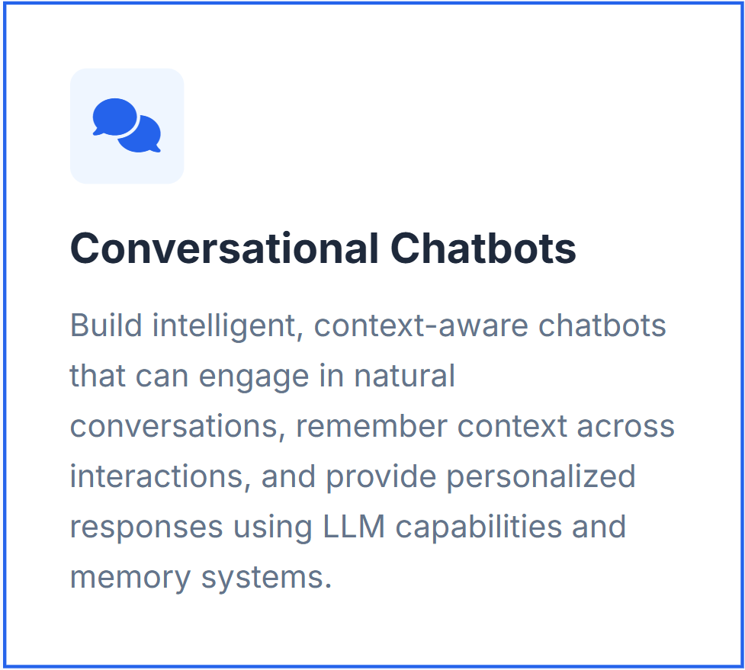
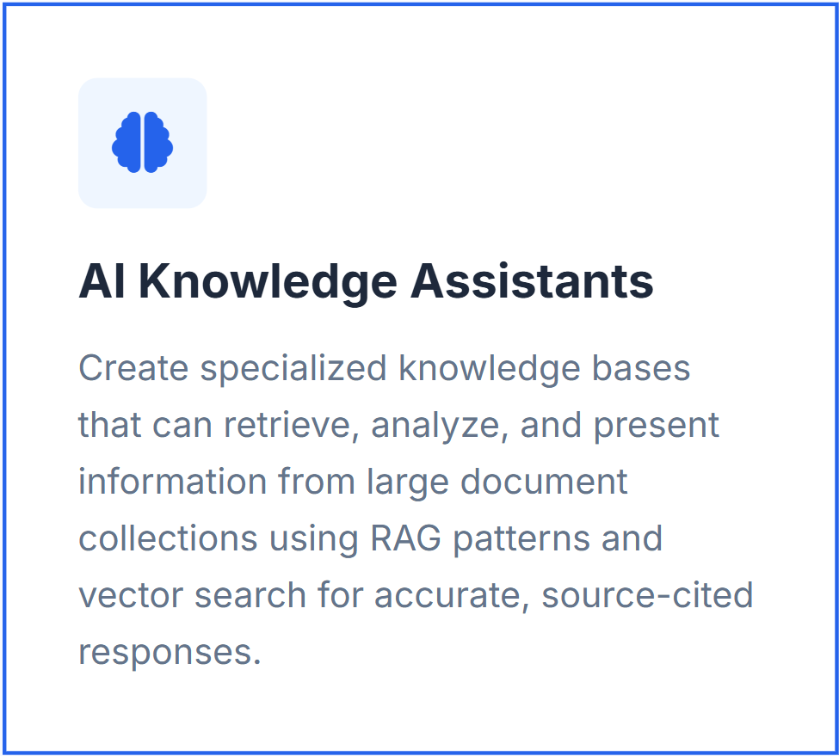
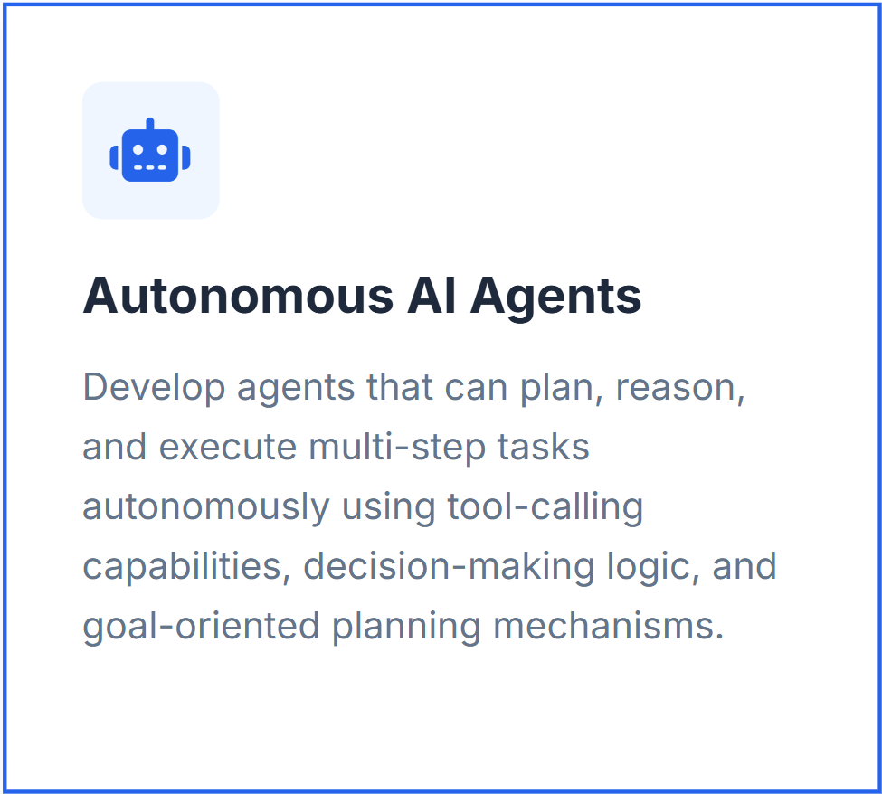
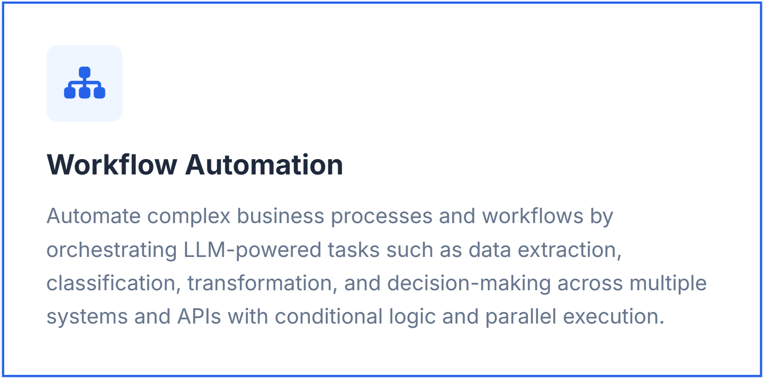
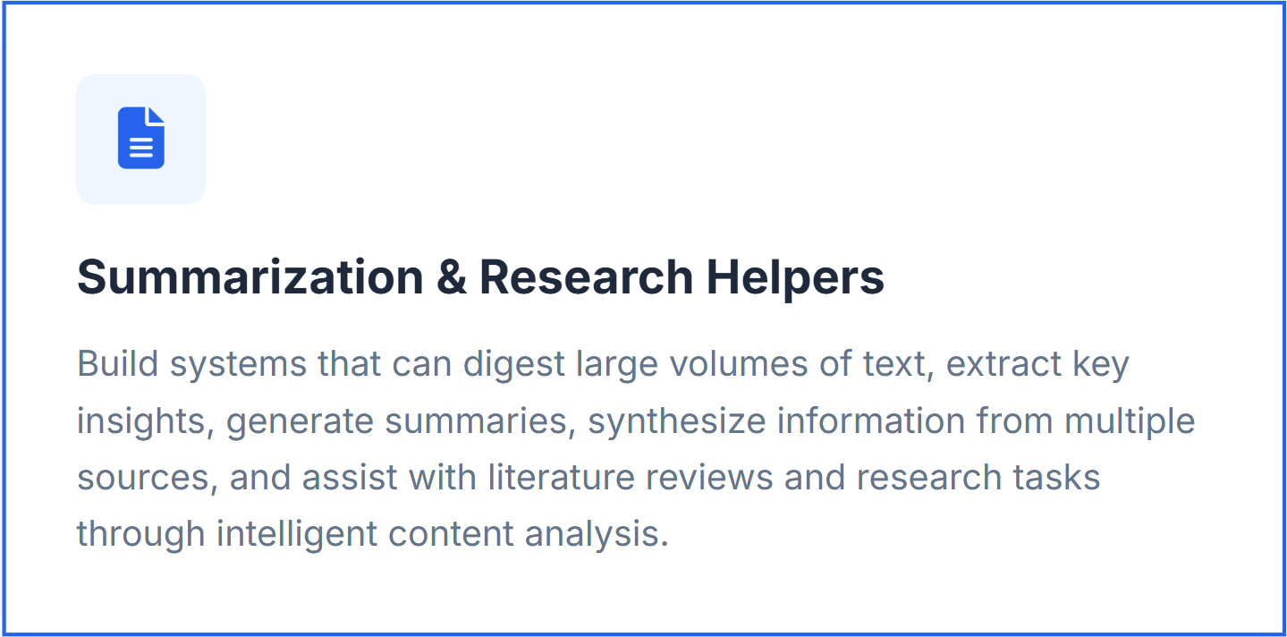
What can we build?

Slide 19
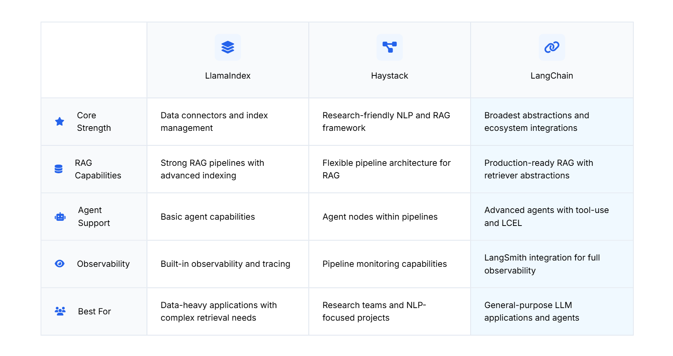
Alternatives: Llama Index and Haystack
Llama index: LlamaIndex - Redefine Document Workflows with AI Agents
Haystack: Haystack | Haystack

Slide 20
LangChain Components
4. Memory
1. Model
LangChain
5. Indexes
2. Prompts
6. Agents
3. Chains

Slide 21
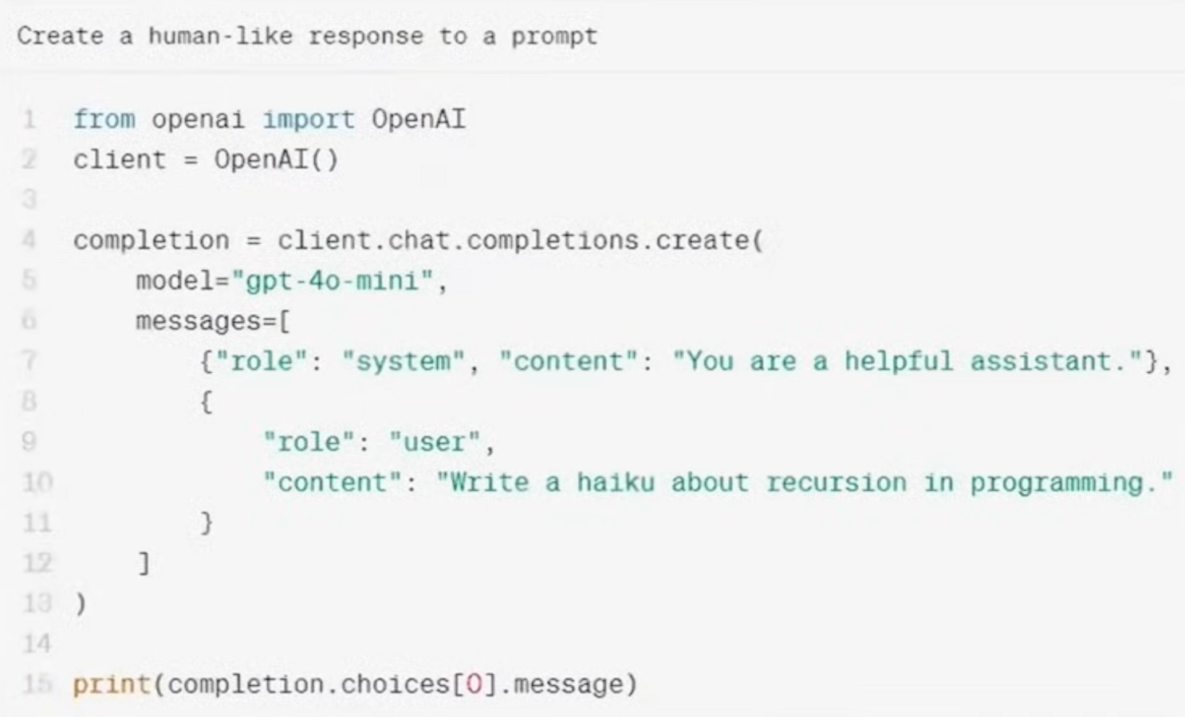
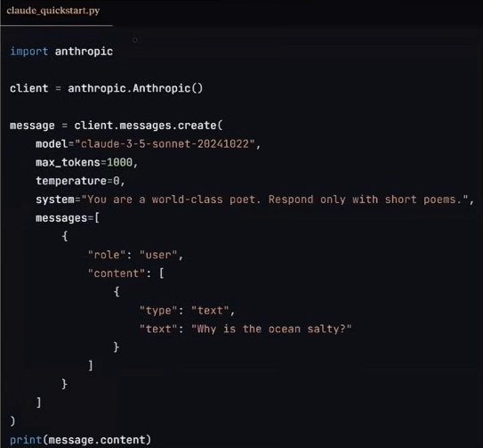
LangChain Components-Models
In LangChain, “models” are the core interface through which you interact with AI models.
OpenAI: gpt-4o-mini
Claude: sonnet

Slide 22
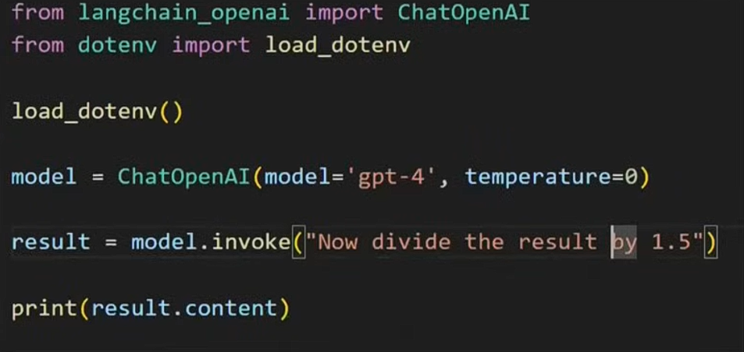
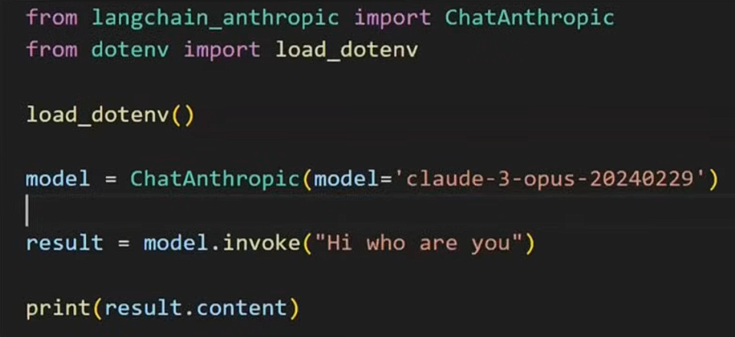
LangChain Components-Models
Using LangChain:
OpenAI: gpt-4
Claude: claude-3
Documentation: Chat models - Docs by LangChain

Slide 23
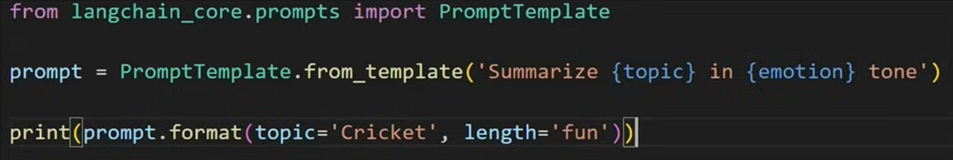
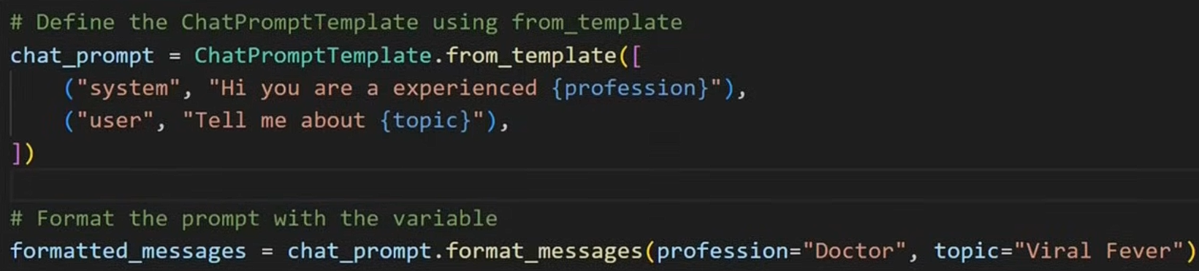
LangChain Components-Prompts
A prompt is a structured template that defines how input is given to an LLM to generate accurate and meaningful responses.
1. Dynamic and Reusable prompt
2. Role-Based prompt

Slide 24
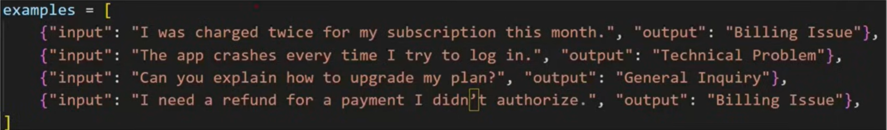
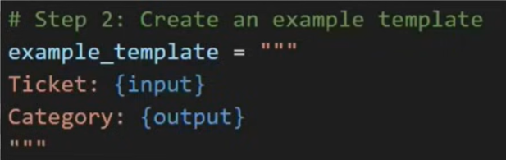
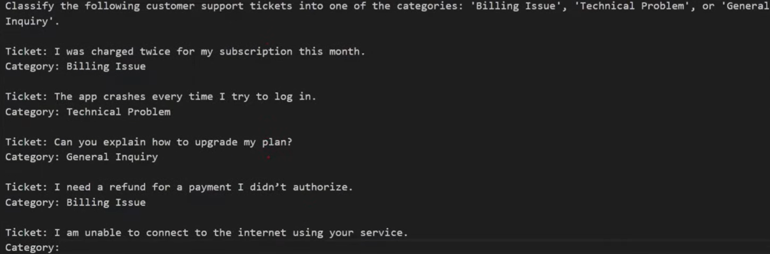
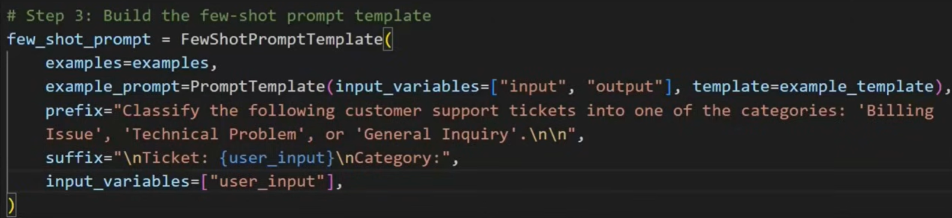
LangChain Components-Prompts
3. Few short prompting

Slide 25
LangChain Components-Chain
A chain is a sequence of connected steps that combine prompts, models, and tools to produce a complete AI workflow.
Example 1:
Input: English text
Output: summary in Nepali
input
LLM-1
translated
LLM-2
summarized
Example 2:
LLM-1
input
report
LLM-3
Final report
LLM-3

Slide 26
LangChain Components-Chain
Example 3:
AI Agents: Customer feedback
Email
Good
Thank you
Input
LLM-1
Bad
Reply email
Conditional Chain

Slide 27
LangChain Components-Indexes
Indexes connect our application to external knowledge such as PDFs, websites and databases.
It includes:
Doc loader
Text splitter
Vector store
Retrievers
Leave policy of XYZ?
Admission policy of XYZ college?
Scholarship rules of XYZ university?
Local municipality emergency numbers?
“LLMs need external knowledge because real-world questions are local, private, and constantly changing.”

Slide 28
LangChain Components- Memory
LLM API calls are stateless.
Who is KP Oli?
KP Oli is a Nepali politician and former prime minister of Nepal.
LLM-API
As an AI. I don’t have access to personal data about individual s unless it has been shared with me.
How old is he?
LLM-API
ConversationBufferMemory: Stores a transcript of recent messages. Great for short chats can grow large quickly.
conversationBufferWindowMemory: Only keeps that last N interactions to avoid excessive token usage.
Summarizer-Based Memory: Periodically summarizes older chat segments to keep a condensed memory footprint.

Slide 29
What are models?
Models components in LangChain is a crucial part of the framework, designed to facilitate interactions with various language models and embedding.
Model
Language models
embedding models
LLMs
Chat Models
Closed Sources
Open Sources
Closed Sources
Open Sources
Closed Sources
Open Sources

Slide 30
Models: Demo
It includes:
LLMs
ChatModels
EmbeddingModels
OpenAI
OpenAI
OpenAI
Claude
Hugging Face
Google
Hugging Face
OpenAI: Overview | OpenAI Platform
Hugging Face: Hugging Face – The AI community building the future.

Slide 31
Models: Demo
1. Create a new folder
2. open it in vs code
3. create a new venv
python -m venv venv or py -m venv venv
4. activate venv
venv\Scripts\Activate
5. create the requirements.txt
pip install -r requirements.txt
7. verify Langchain Installation

Slide 32
Way to use open-source models:
Open-Source Model
Using Hugging Face inference API
Run Locally

Slide 33
What are outputs?
In LangChain, an output is simply what the chain, model, or agent returns after processing your input.
LLM default output = Unstructured
Most LLMs naturally reply like a human:
paragraphs
mixed formatting
extra explanations
inconsistent fields
Example (unstructured):
“The user is Ram. He is 21 years old and lives in Kathmandu. Priority is high.”
This is nice for reading, bad for databases/APIs, because:
DB needs fixed columns
APIs need predictable JSON schema
automation breaks if format changes

Slide 34
Way to get structured output
LLMS
Can
Can’t
With_Structured_output
Parser
TypedDict
StrOutput
Pydantic
PydanticOutput
JSON
JSONOutput

Slide 35
What are chain in langchain?
A chain in LangChain is just a sequence of steps where the output of one step becomes the input of the next.
output
output
output
Simple Chain
Sequential Chain
output
output
output
output
output
output
Conditional Chain
Parallel Chain

Slide 36
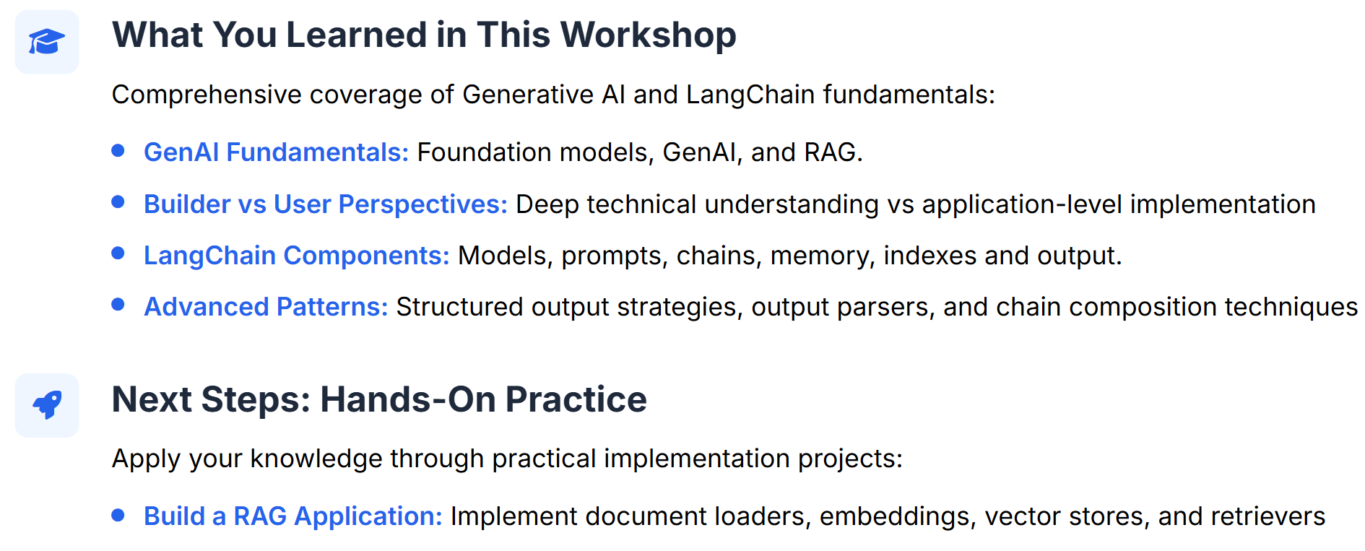
Summary & Next Steps

